Slide 1
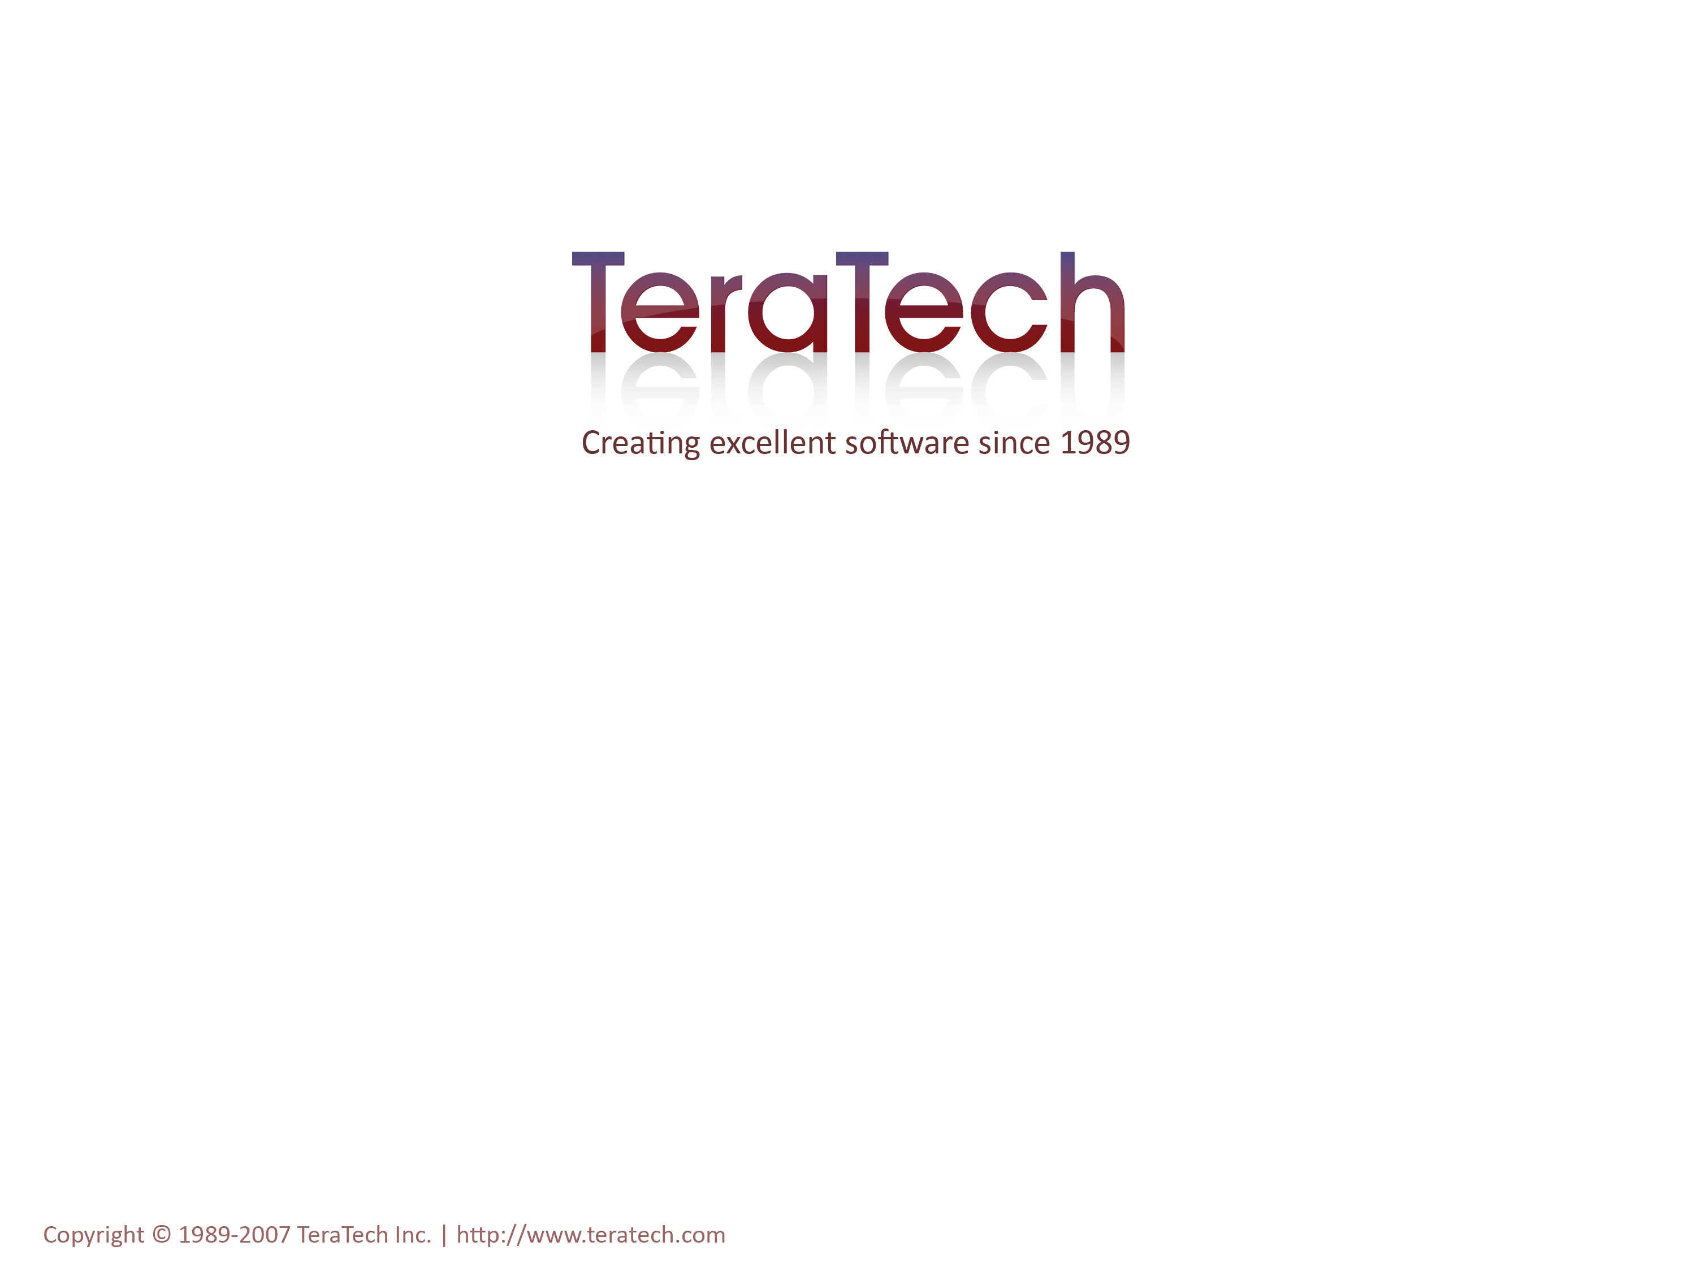
Wiring It All Together
Dependency Injection with ColdSpring

Slide 2
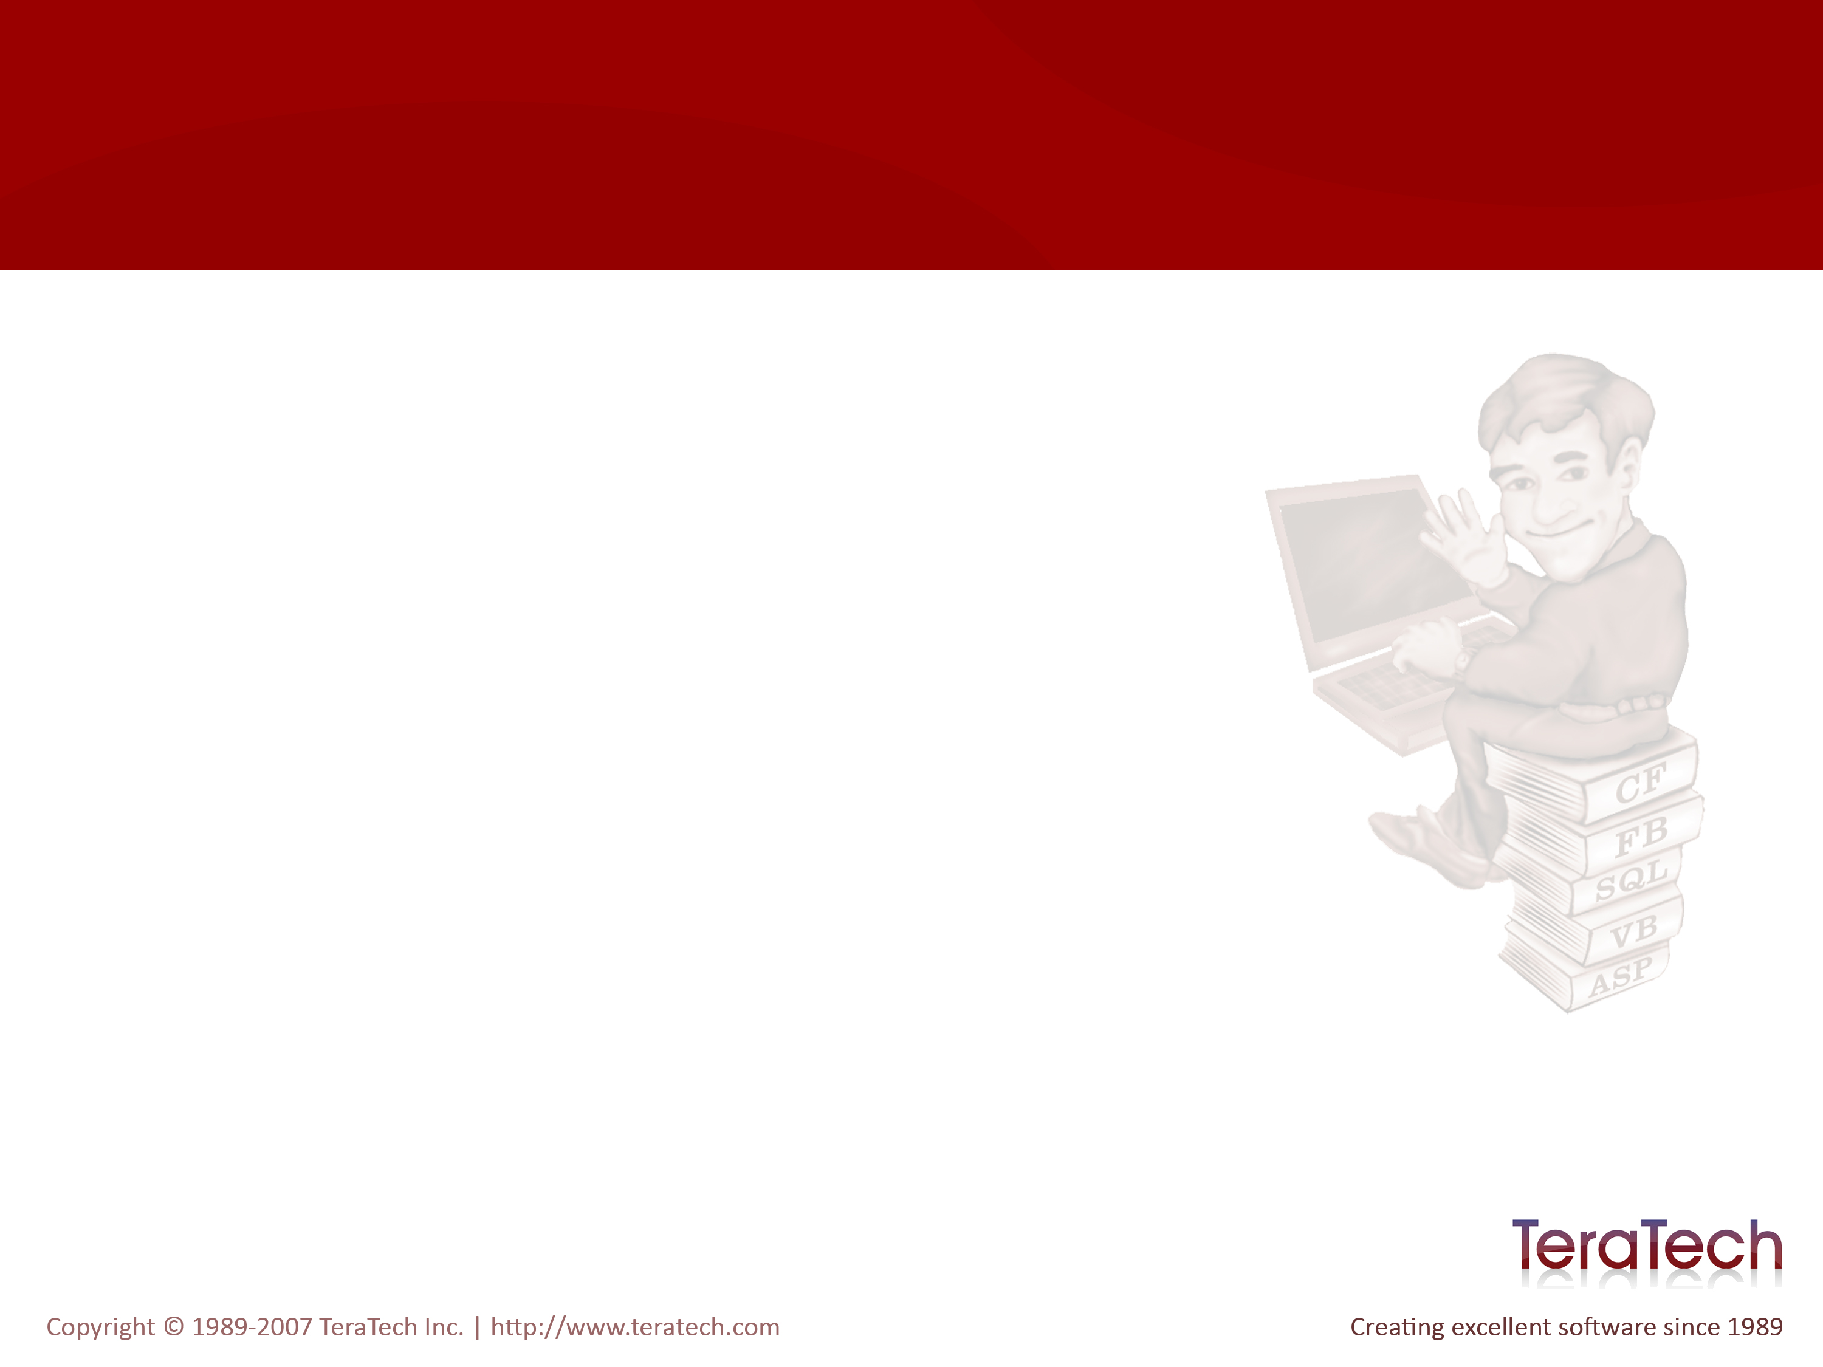
ColdSpring
In simplest terms, a configuration framework
Based on the Java Spring Framework

Slide 3
Yet More Design Patterns
The Factory Pattern
  ColdSpring “builds” your objects
Dependency Injection / Inversion of Control
  Provides looser coupling between components
  Dependencies are passed to components when they are instantiated

Slide 4
The Factory Pattern
A “Factory” component knows how to “build” another type of component.
Think of an automotive factory...
  You ask the factory to build you a nice new car.
  The factory gives you your car.
  You don’t care how it was built.
The CreateObject() method is a good example of the Factory pattern.

Slide 5
The Dependency Injection Pattern
First, let’s cover “Loose Coupling”…

Slide 6
Loose Coupling
Cohesive Components are easier to write and maintain.
Cohesive Components do one thing well.
An uncohesive component is one that does a number of different (possibly related) things, but specializes in none.
  Blog CFC (sorry, Ray) – does everything related to a blog.
  One CFM to rule them all!
  One component that does all data access
Cohesiveness is worthy goal…
  But, what if they need to do more than one thing?

Slide 7
Dependencies
The engine in a car doesn’t provide the energy to run it, the fuel does. Yet, the engine is dependant on the fuel to do it’s job.
Components can, and often do, use other components to complete their jobs.
  A mortgage calculator might use a compound interest calculator to determine payments
  A security system might use different components as interfaces to LDAP, databases, or other security stores.

Slide 8
Getting Our Dependencies
You could Instantiate needed components inside your component.
  <cfcomponent>
    <cfset Fuel = CreateObject(....) />
    <cffunction name="startEngine">
    <cfset var energy = Fule.burn() />
    ....
    </cffunction>
  </cfcomponent>
But what about these other component’s dependencies and configuration values?
  You have to repeatedly configure that component.
  Changes to how the component is created impact every creation point.
  The engine shouldn’t decide what octane fuel to use.
If you’re creating a component in another, you’re tightly coupling the two components.

Slide 9
Loosen The Coupling
Pass your dependencies in during construction:
  <cfset Fuel = CreateObject(....) />
  <cfset Fuel.setOctane("High") />
  <cfcomponent>
    <cffunction name="init">
      <cfargument name="Fuel" />
      ....
    </cffunction>
    <cffunction name="startEngine">
      <cfset var energy = Fule.burn() />
      .....
    </cffunction>
  </cfcomponent>

Slide 10
Dependency Injection
Also known as Inversion of Control
A pattern whereby a Factory creates a component and provides it with all of it’s dependencies for you.
Knows how to create objects based on configuration.
<cfset Engine = MyFactory.getObject("Engine") />

Slide 11
But Isn’t That a Dependency?
No!
The object being created has no knowledge of the Factory.

Slide 12
Bean Pattern
A bean is simply an object with getters and setters.
DI/IOC Factories use the bean pattern and the init() convention.
Random Note: Have you noticed that none of the patterns we’ve discussed stand alone? They all work together.

Slide 13
ColdSpring
An IOC Factory for ColdFusion
Configured via XML
A very simple API
There’s more to the framework too, but we’re not going to look beyond dependancy injection.

Slide 14
Configuring ColdSpring
Configured via ColdSpring.xml
Located under /Config by default

Slide 15
The Basic ColdSpring.xml Structure
<beans> (only one)
  <bean> (zero or more)
    <constructor-arg> (zero or more)
    <property> (zero or more)

Slide 16
Setting Constructor or Property Values
<constructor-arg>
  Maps to init arguments
<property>
  Maps to setters
These accept…
  <value> – a simple value
  <ref> – a reference to another “bean”
  <bean> – a bean / component
  <map> – a structure
  <list> – an array

Slide 17
<value />
Specifies a simple value
<value>15</value>

Slide 18
<ref />
Specifies a reference to another bean configured with a <bean> tag.
<ref bean="myBeanId"/>

Slide 19
<map/>
Specifies a simple structure of name/value pairs
  <map>
  <entry key="foo">
  <value>5</value>
  </entry>
  <entry key="bar">
  <ref id="barBean"/>
  </entry>
  </map>

Slide 20
<list/>
Specifies an array of values
  <list>
    <value>5</value>
    <ref id="barBean"/>
  </list>

Slide 21
<bean/>
Specifies an object (“bean”) which implements the Bean pattern.
<bean id="Datasource" class="Fortune - ColdSpring.model.Datasource">
<constructor-arg name="datasource">
<value>Fortune</value>
</constructor-arg>
<constructor-arg name="username">
<value></value>
</constructor-arg>
<constructor-arg name="password">
<value></value>
</constructor-arg>
</bean>

Slide 22
Creating The BeanFactory
The ColdSpring.beans. DefaultXmlBeanFactory used to load XML configuration.
<cfset ColdSpring = CreateObject("component", "coldspring.beans.DefaultXmlBeanFactory").init() />
<cfset ColdSpring.loadBeans("/path/to/ColdSpring.xml") />

Slide 23
Creating Beans
Use getBean() to create an instance of a configured object
Singletons by default
  Yet another design pattern
  <cfset CategoryGateway = ColdSpring.getBean("CategoryGateway") />

Slide 24
How CS and MG Fit Together
ColdSpring used to configure the entire Model-Glue framework.
  The nice side effect is that you can modify the behavior of Model-Glue without touching any of the core files.
Model-Glue will automatically “wire” your controllers with configured objects.
  Looks for setters (setXYZ) on controller and their type.
    setXyz() – accepts model.Xyz
  Looks in ColdSpring configuration for a component with the same name and type.
    <bean id="Xyz" type="model.Xyz" />

Slide 25
Facades and SEO
Facades
  The Fortune CFC no longer performs all (any) tasks related to retrieving the fortune.
  Simply makes it easier to use the underlying model.
Service Oriented Architecture
  The Fortune service is simply a collection of methods which perform a set of related services.
  Often one method per system use case.
  Can be exposed as a web service, to flash remoting, etc.
Not tied (at all) to Model-Glue or ColdSpring

Slide 26
Workout Time
You have 30 minutes
Make your Fortune cfc into a Fortune Service
Configure your model using ColdSpring
Update your unit tests to use ColdSpring to create objects (where appropriate)

Slide 27
Let’s Discuss
How did this “feel”?
Does this seem like more code or less?
Do you think this could be more easily maintained?
What if you were to switch database platforms?
What if you needed to add support for a second database platform?

